Slide 1
Frontend Development with React:

Slide 2
Frontend Development with React is an exciting journey that empowers you to build interactive and dynamic user interfaces. Here's an overview of the topics you mentioned:

Slide 3
1.Introduction to React and its Core Concepts:
React is a JavaScript library for building user interfaces. It allows you to create reusable UI components and manage their state efficiently. The core concepts include:
Components: React is component-based, which means you create UI elements as reusable components.
State: React components can have their own state, which allows them to manage and display data.
Props: Props (short for properties) are a way to pass data from a parent component to a child component.

Slide 4
2.Creating a Basic React Application with JSX:
You set up a React application using tools like Create React App (CRA) or manually configure your development environment.
JSX (JavaScript XML) is a syntax extension for JavaScript that allows you to write HTML-like code within your JavaScript files. JSX is used to define the structure of React components.

Slide 5
3. Managing Application State with React Hooks:
React introduced hooks in version 16.8 to manage state and side effects more easily. Commonly used hooks include:
useState: Used to manage component-level state.
useEffect: Allows you to perform side effects in functional components.
Other hooks like useContext, useRef, and useReducer serve specific purposes.

Slide 6
4. Handling User Input and Forms in React:
React provides a controlled component approach for handling form inputs. You store input values in component state and update them via event handlers.
Commonly used form elements include input, textarea, and select.
You can use libraries like Formik and react-hook-form to simplify form management.

Slide 7
5. Styling React Components with CSS:
There are several ways to style React components, including:
Using plain CSS files and importing them into your components.
Inline styling using the style prop.
CSS-in-JS solutions like styled-components or Emotion.
Utility-first CSS frameworks like Tailwind CSS.

Slide 8
Here's a simple example of a React component that incorporates these concepts:
import React, { useState, useEffect } from 'react';
function Counter() {
const [count, setCount] = useState(0);
useEffect(() => { document.title = `Count: ${count}`; }, [count]);
const handleIncrement = () => { setCount(count + 1); };
return ( <div> <h1>Counter App</h1> <p>Count: {count}</p> <button onClick={handleIncrement}>Increment</button>
</div> );
}
export default Counter;

Slide 9
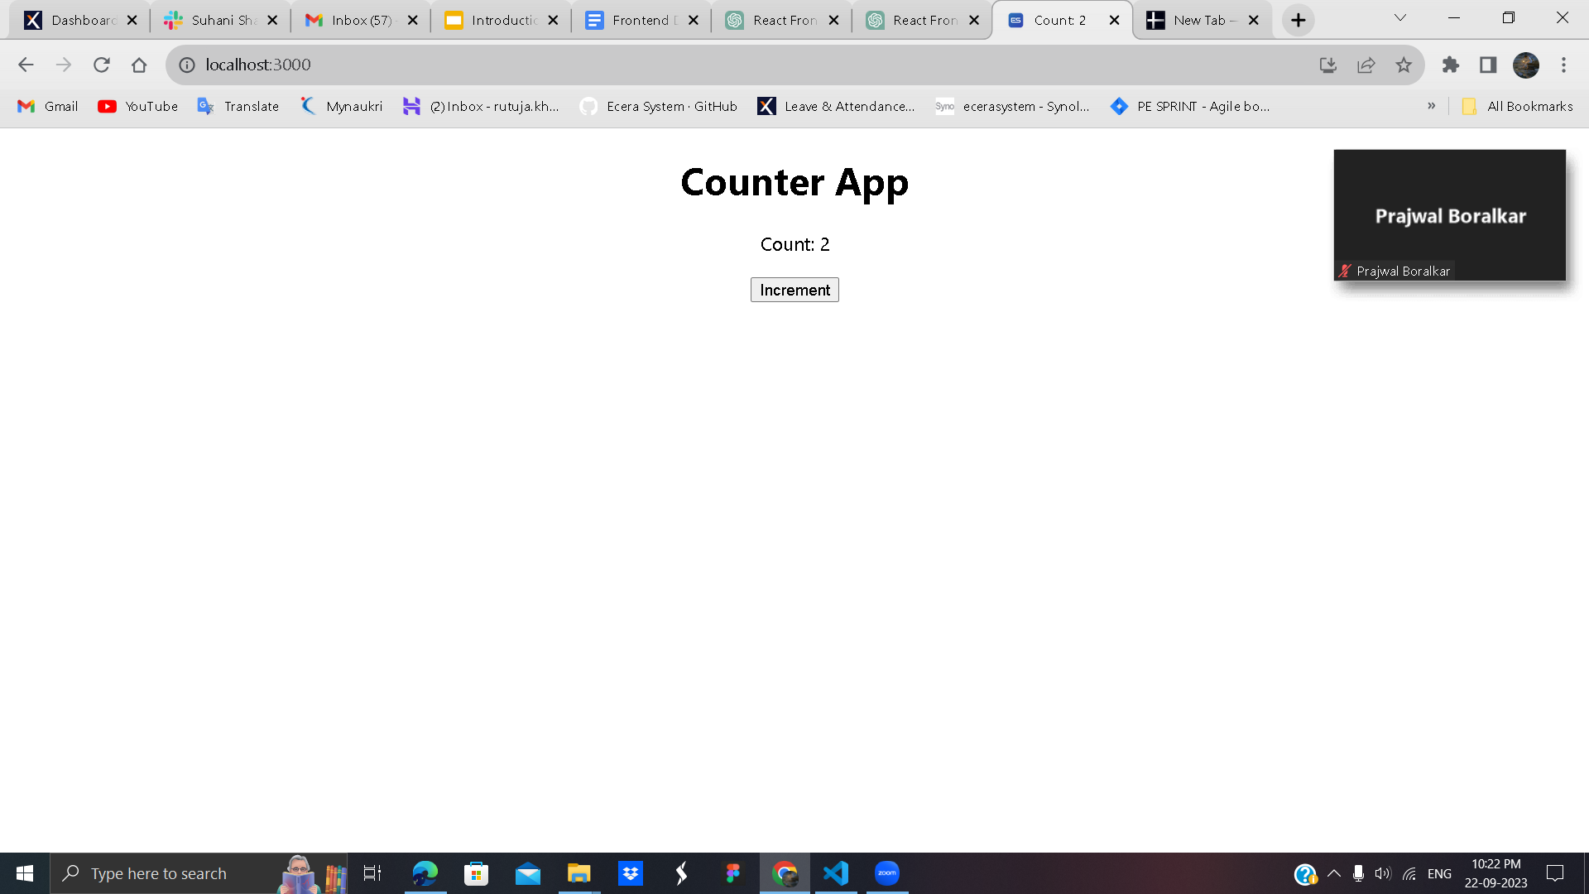
After running the code you will get this window.

